Slide 1
Presentation On Star Topology
Jahirul Islam
ID No. 1205053
Batch : ID-NT/ACSL-01M/R28/01

Slide 2
What Is Star Topology
A star network or star topology is one of the most common network setups.
In this configuration, every node connects to a central network device. The central network device acts as a server.

Slide 3
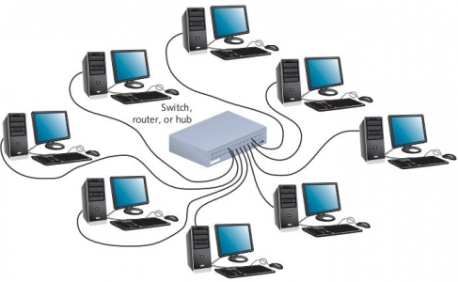
Star Topology

Slide 4
Advantages of Star Topology
Easy to install and wire.
Easy to connect new nodes or devices.
No disruptions to the network when connecting or removing devices.
Easy to detect faults and to remove parts.
Star networks are very reliable. If one connection fails, it does not affect other users

Slide 5
Thank You

